Slide 1
Null-text Inversion for Editing Real Images using Guided Diffusion Models
Imagic: Text-Based Real Image Editing with Diffusion Models

Slide 2
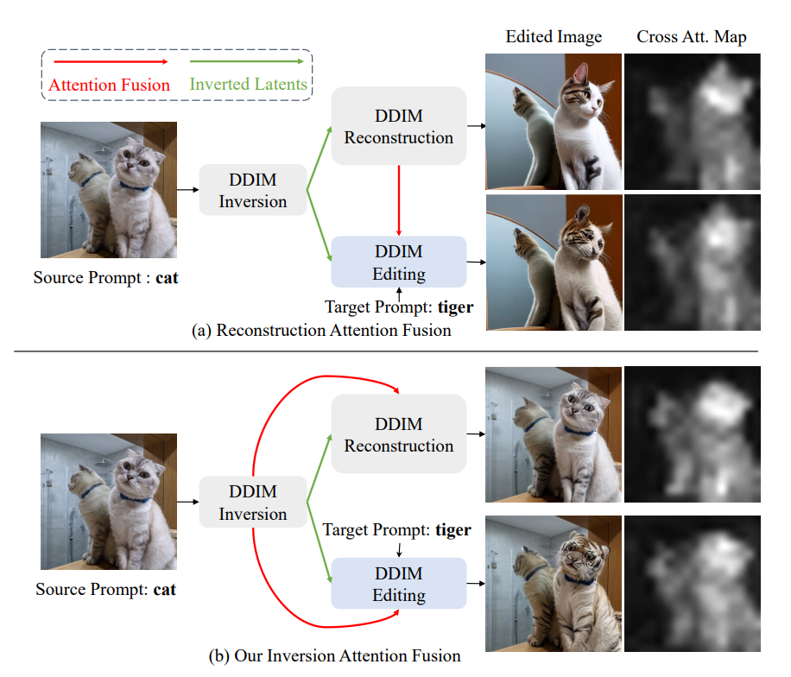
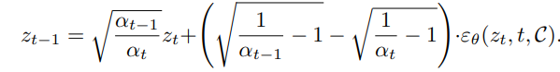
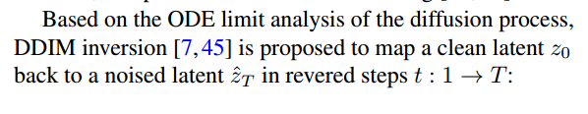
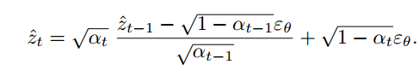
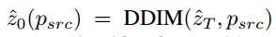
背景
（1）classifier-free guidance
（2） DDIM Inversion
在实践中，DDIM Inversion每一步都会产生误差，对于无条件扩散模型，累积误差可以忽略。但是对基于classifier-free guidance（ w>1 ）的扩散模型，累积误差会不断增加, DDIM Inversion最终获得的噪声向量可能会偏离高斯分布，再经过DDIM采样，最终生成的图像会严重偏离原图像
Notes:
在实践中，DDIM Inversion每一步都会产生误差，对于无条件扩散模型，累积误差可以忽略。但是对基于classifier-free guidance（ �>1 ）的扩散模型，累积误差会不断增加，DDIM Inversion最终获得的噪声向量可能会偏离高斯分布，再经过DDIM采样，最终生成的图像会严重偏离原图像，并可能产生视觉伪影

Slide 3
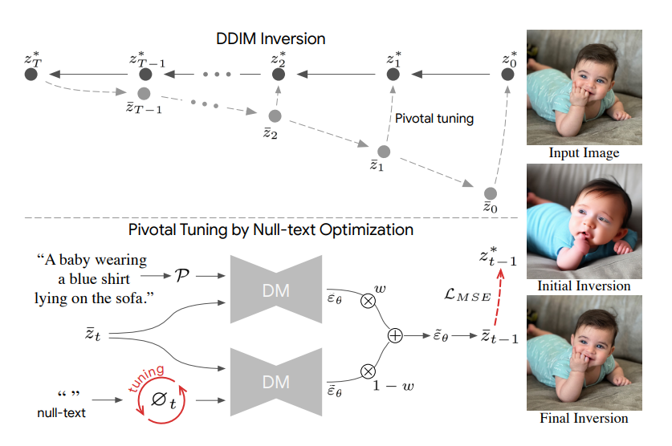
Pivotal Inversion

Slide 4
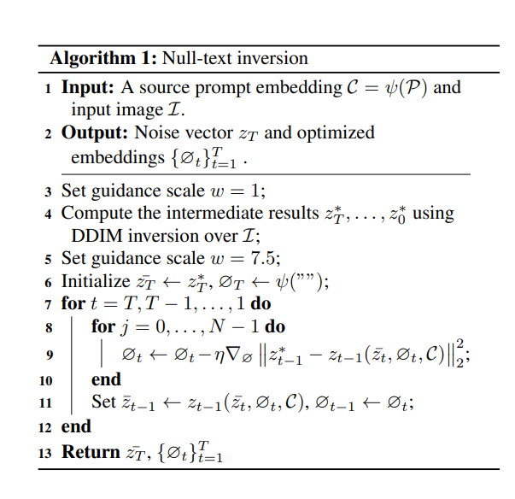
Pivotal Inversion
Notes:
最后，可以使用噪声�¯�=��∗ 和优化后的Null-text Embedding {∅�}�=1� 进行图像编辑。

Slide 5
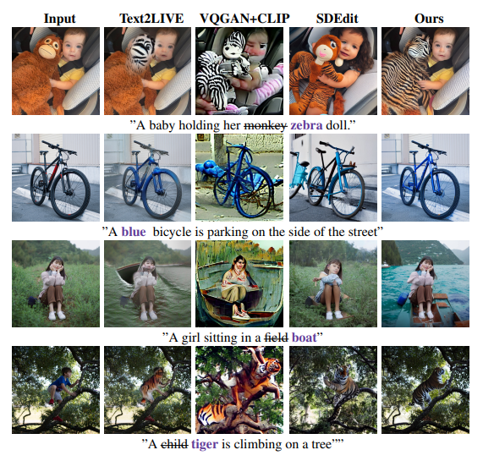
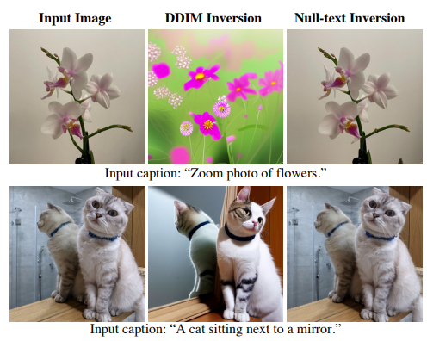

Slide 6
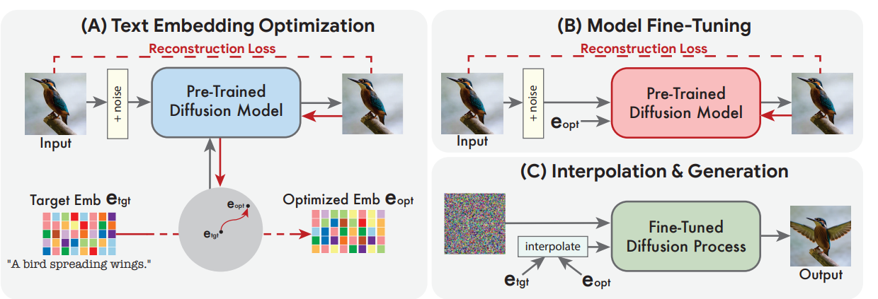
Imagic
optimize the text embedding
fine-tune the diffusion models
Text embedding interpolation
目标：给定输入图像x和描述编辑操作的文本，实现保留x
最多细节的前提下，满足指定文本的修改

Slide 7
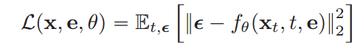
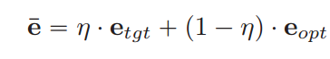
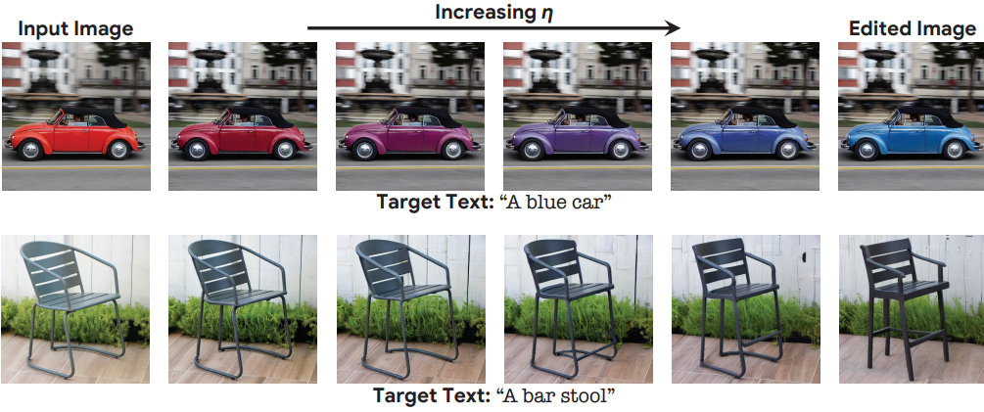
optimize the text embedding
Text embedding interpolation
find one that best matches the given image in the vicinity of the target text embedding
前两步做的都是重建的操作，第三步才涉及编辑操作
run this process for relatively few steps, in order to remain close to the initial target text embedding
use the finetuned model to apply the desired edit by advancing in the direction of the target text embedding
Model fine-tuning
close this gap by optimizing the model parameters θ using the same loss function, while freezing the optimized embedding

Slide 8
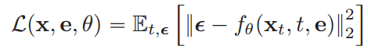
Experiments based on Imagen
Configs on Imagen
64*64 diffusion model on embedding optimization
Adam optimizer for 100 steps
fixed learning rate of 1e-3
64*64 diffusion model on finetuning the model
Training for 1500 steps , conditioned on the optimized embedding
64*64 -> 256*256 SR diffusion model
Training for 1500 steps , conditioned on the target embedding
entire optimization process takes around 8 minutes per image on two TPUv4 chips
generative diffusion model for 64*64 pixel images
SR diffusion model turning 64*64 into 256*256
SR model transforming 256*256-pixel images into the 1024*1024 resolution
Model fine-tuning
Use the same reconstruction loss, but conditioned on target embedding in order to capture high-frequency details from the original image
Configs on SD
SD on embedding optimization
Adam optimizer for 1000 steps
fixed learning rate of 2e-3
SD on finetuning the model
1500 steps with a learning rate of 5e-7
takes 7 minutes on a single Tesla A100 GPU

Slide 9
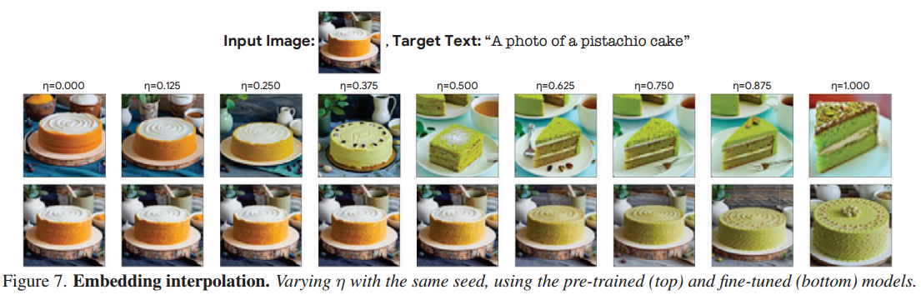
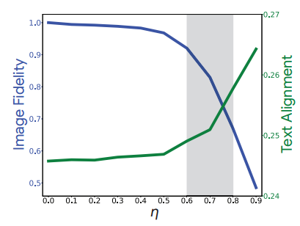
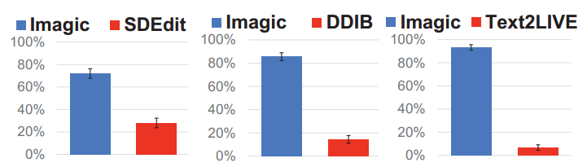
Experiments

Slide 10
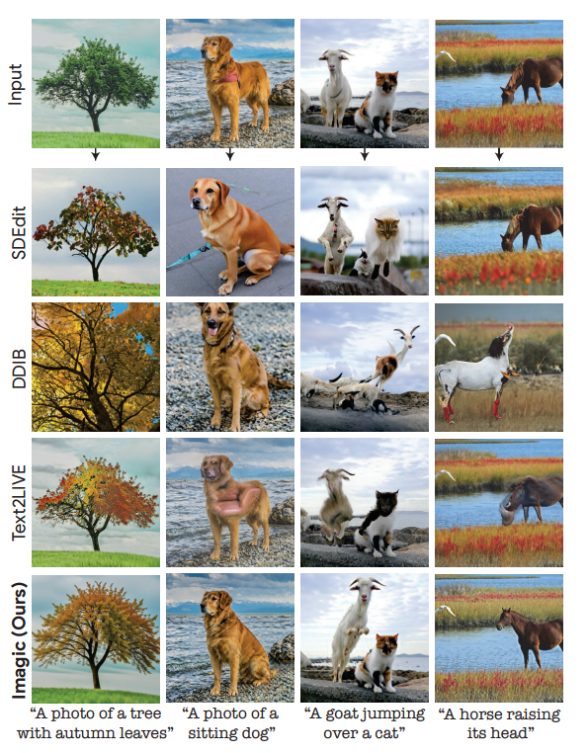
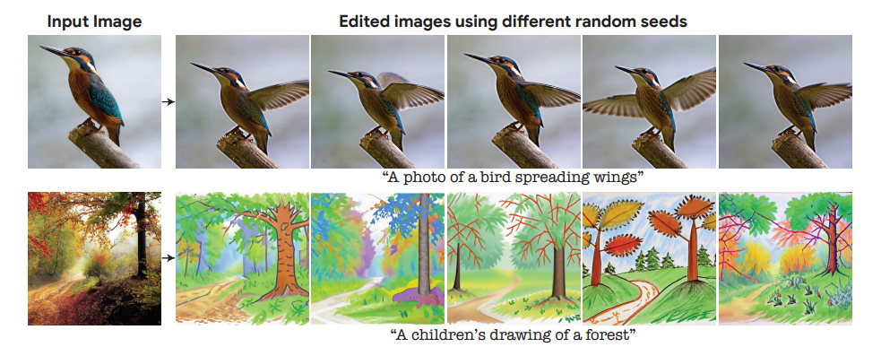
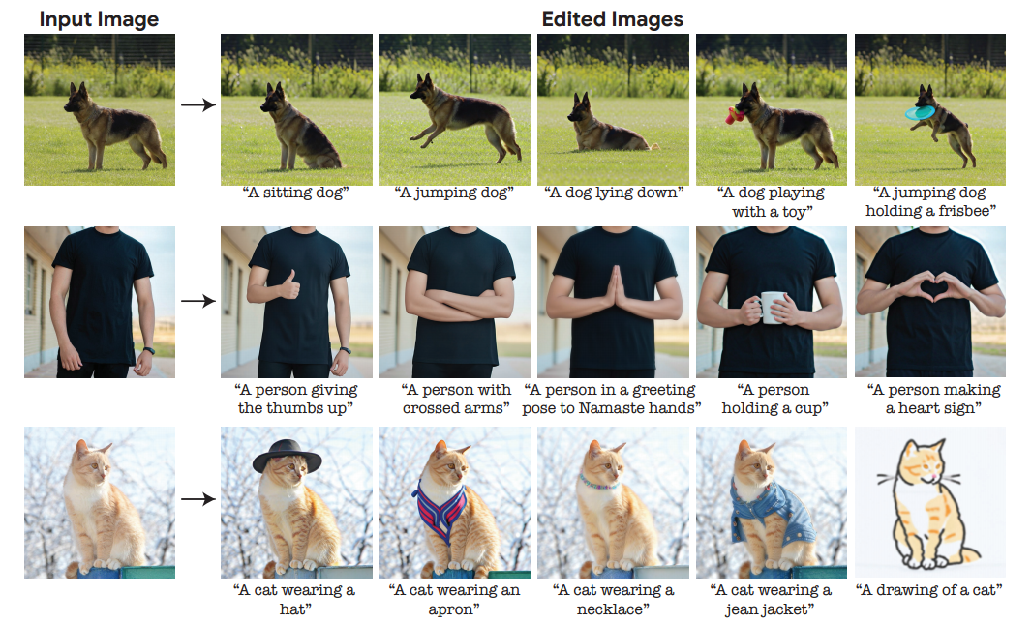

Slide 13
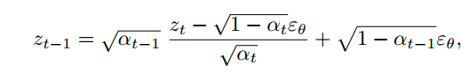
DDIM Sampling:
DDIM Inversion:
Notes:
直接使用inverted latents会导致帧间不一致
原因：1）DDIM inversion的式子只在小时间步下有效，DDIM50步，误差会累积 2）Classifier-free guidance提高了图像编辑能力，但是自由度也会导致帧间不一致
这些问题在图像编辑上还好，在视频上问题会放大
之前的方法：optimization of text-embedding [16] or other regularization

